Slide 1


HOUSE PREDICTION DATASET – EXPLORATORY DATA ANALYSIS REPORT
Prepared By :
Omar Makram

Slide 2
INTRODUCTION
The dataset used in this analysis is the House Price Prediction (Boston Housing) dataset. It contains a set of neighborhood‑level features such as crime rate, number of rooms, pollution levels, access to highways, and socio‑economic indicators, alongside the target variable MEDV, which represents the median value of homes.
The main goal of working with this dataset is to understand which factors have the strongest impact on house prices and how these features interact. This analysis helps build a clear foundation for predictive modeling and for identifying the key drivers of housing value.
Summary of Key Findings
Homes with more rooms (RM) tend to be significantly more expensive.
Areas with higher LSTAT (lower socio‑economic status) show sharp declines in home values.
Proximity to the Charles River (CHAS) is associated with noticeably higher prices.
MEDV has a price ceiling at 50, which indicates capped values in the dataset.
Strong correlations such as RAD–TAX and NOX–INDUS highlight multicollinearity that must be handled during modeling.

Slide 3
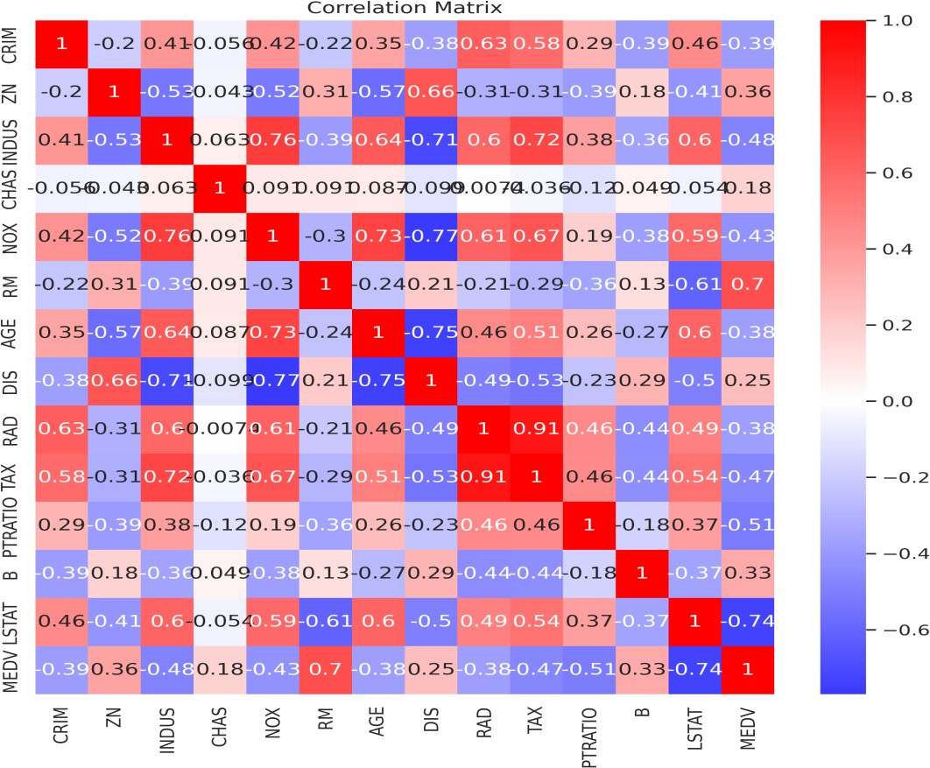
Correlation Matrix Insights
Key Insights:
There is a strong positive correlation between RM (number of rooms) and MEDV
(house price)
→ Houses with more rooms tend to be more expensive.
LSTAT shows a strong negative relationship with MEDV
→ Areas with a higher percentage of lower-status population tend to have lower house prices.
NOX (pollution level) is negatively correlated with MEDV
→ Higher pollution is associated with lower property values.
CRIM (crime rate) has a negative but moderate correlation with MEDV
→ Higher crime may reduce house prices, but the effect is not very strong.
There is a very strong positive correlation between RAD and TAX
→ Areas closer to highways tend to have higher property taxes.

Slide 4
PTRATIO has a negative relationship with MEDV
→ Higher student-to-teacher ratios are linked to lower house prices.
DIS shows a weak positive relationship with MEDV
→ Distance from employment centers has a slight and unclear effect on prices.
Modeling Implication:
Prioritize RM and LSTAT as primary predictors. Handle multicollinearity (RAD–TAX, NOX–INDUS) via regularization or feature selection.

Slide 5
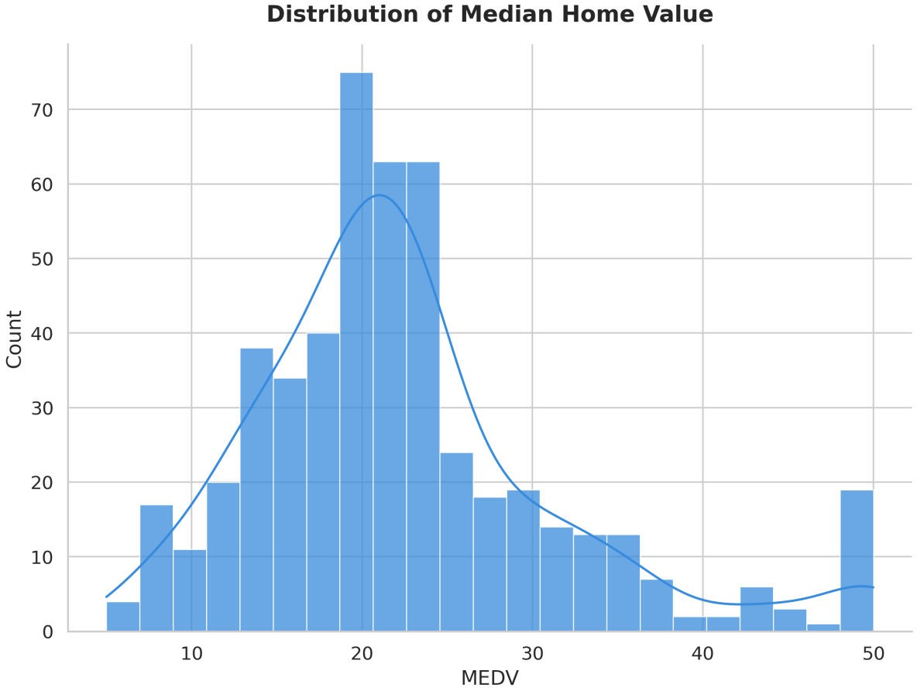
MEDV Distribution Insights
Key Insights:
Most home values fall between $15k and $25k, indicating a predominantly mid‑market housing environment.
A hard cap near $50k suggests price ceiling / censored values, especially for premium properties.
Distribution is right-skewed, meaning high-value homes are underrepresented or limited.
The market shows strong concentration in the middle range with few true high-end homes.
Modeling Implication:
The non-normal distribution and ceiling effect may bias linear model assumptions; consider transformations or models robust to censoring.

Slide 6
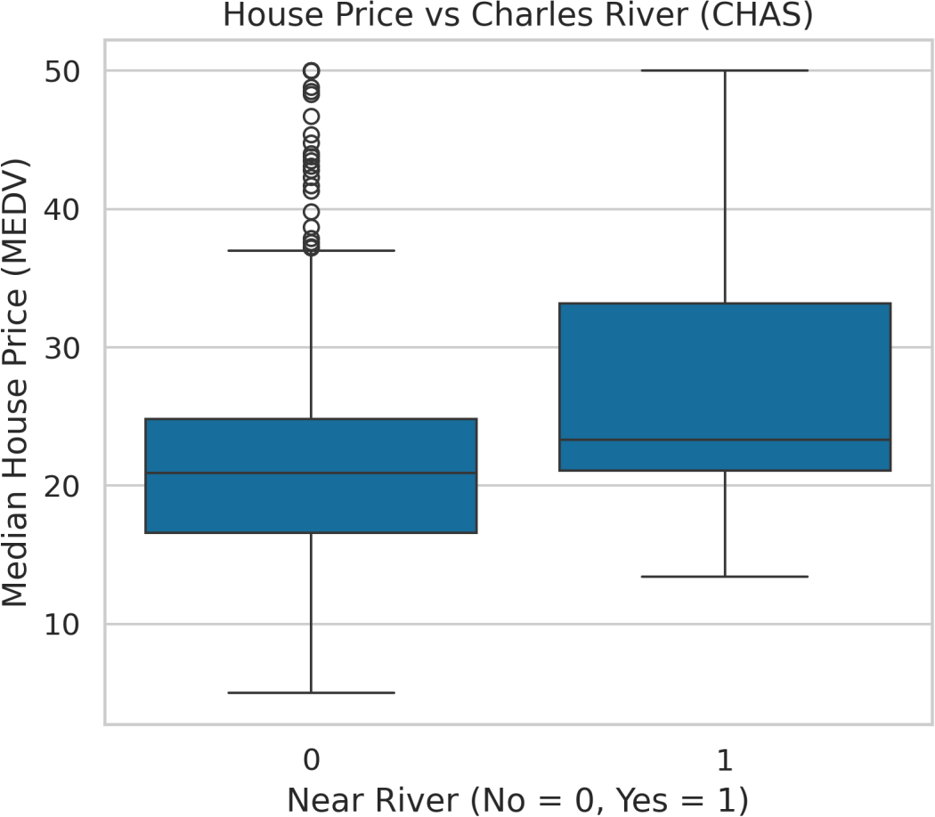
CHAS vs. MEDV Insights
Key Insights:
Homes near the Charles River (CHAS = 1) are significantly more expensive on average than those farther away.
Riverfront homes show a wider price range, indicating a mix of premium properties.
Proximity to the river creates a clear value premium, reflecting environmental and location desirability.
CHAS is relatively rare (small n), so results should be interpreted with caution.
Modeling Implication:
Treat CHAS as an impactful categorical feature but account for class imbalance during modeling.

Slide 7
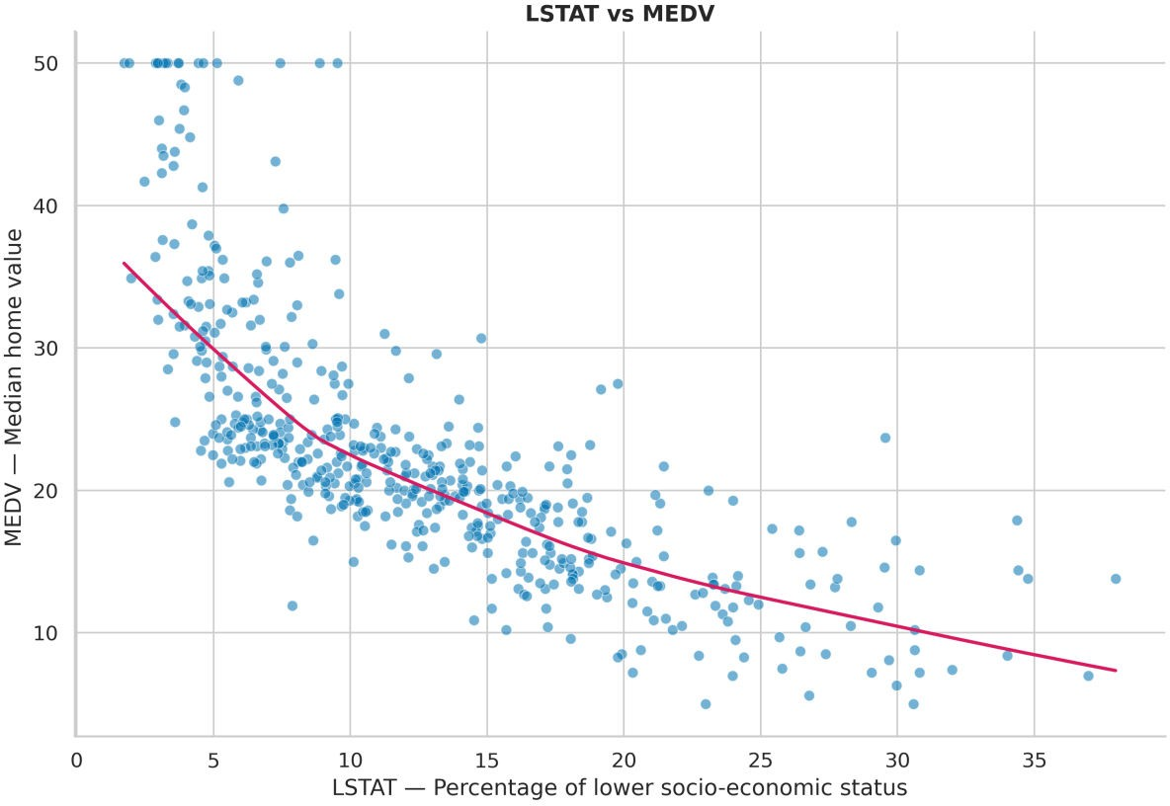
LSTAT vs. MEDV Insights
Key Insights:
The relationship is strongly non-linear — price drops faster at higher LSTAT levels.
Low LSTAT (3–8%) areas consistently contain the highest-valued homes.
Once LSTAT exceeds ~20%, property values fall sharply and remain low regardless of other features.
LSTAT is one of the most powerful socio‑economic predictors of housing value.
Modeling Implication:
Spearman correlation tends to be stronger than Pearson here; allow curvature in models (e.g., polynomial terms or tree-based models).

Slide 8
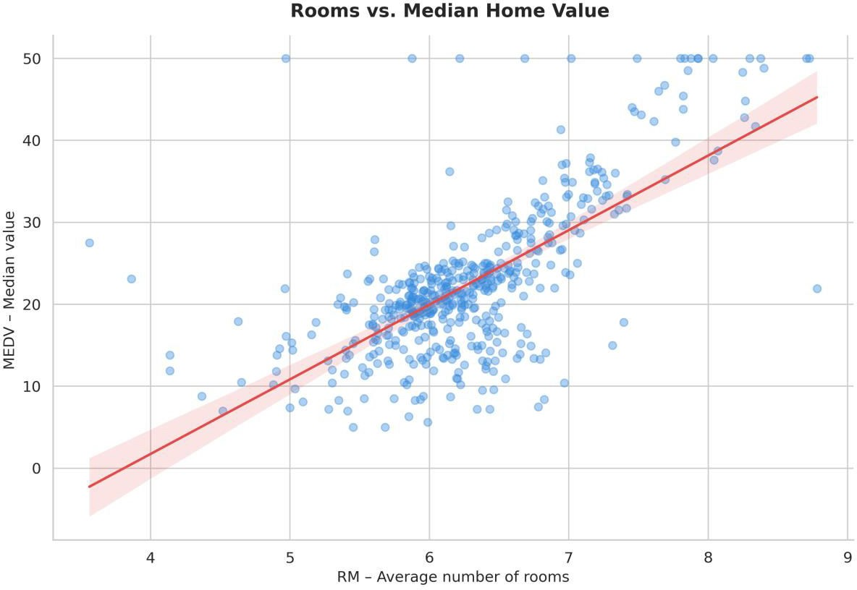
RM vs. MEDV Insights
Key Insights:
Strong linear positive relationship — more rooms directly increase price.
Homes with 7+ rooms almost always fall in the high-value range.
Homes with 4–5 rooms cluster at the low-to-mid value range.
RM is a top predictor for modeling, showing clean, consistent upward trends.
Modeling Implication:
RM is ideal for linear regression and feature engineering (interaction or nonlinearity with LSTAT)

